Slide 1
Hobbies
Passions
Physical Features
Identity Maps
Favorite things
Ideas
Personality Traits
Personal History

Slide 2
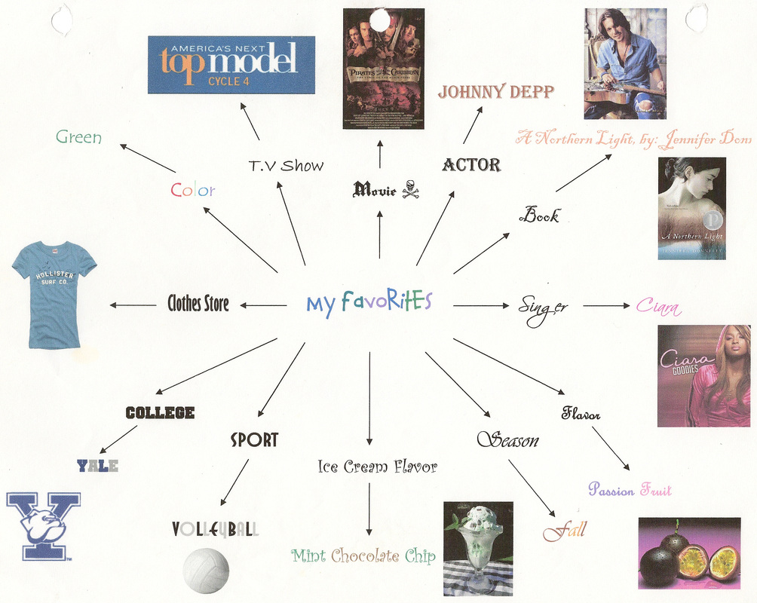

Slide 3
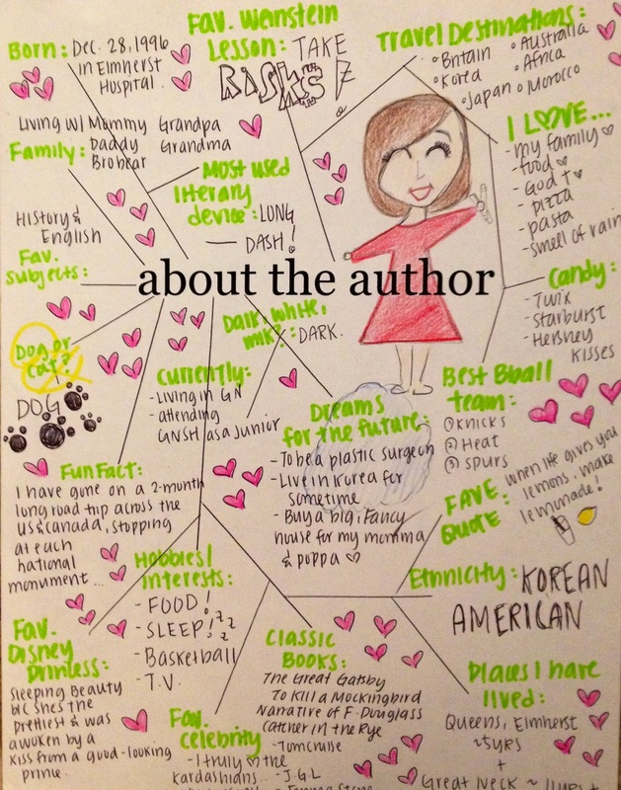

Slide 4
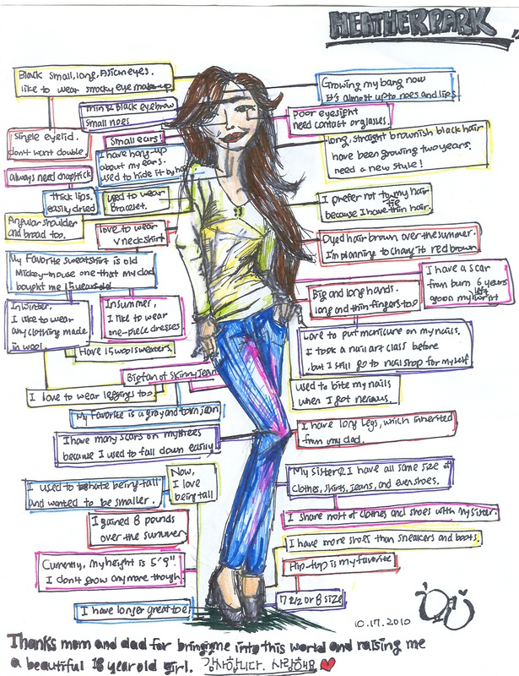

Slide 5
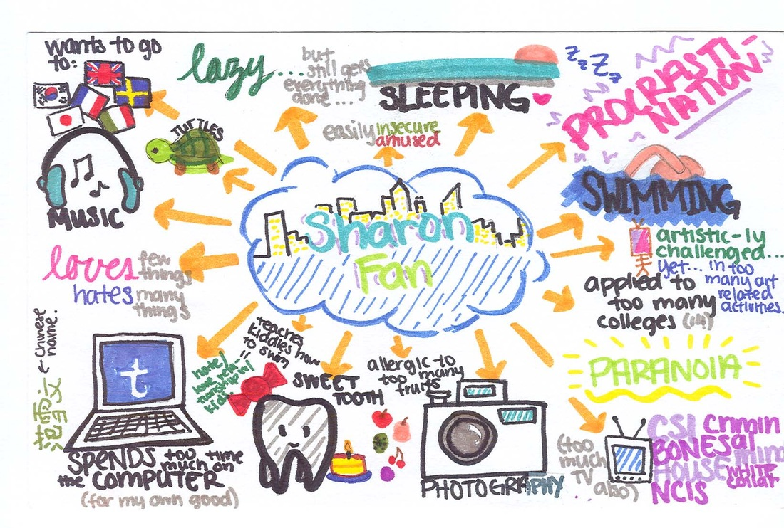

Slide 6
